Slide 1
Spring Framework

Slide 2
Content
What is Spring Framework?
Key features of Spring Framework
Dependency Injection and Inversion of Control
Aspect Oriented Programming
Spring Modules
Advantages of using Spring Framework

Slide 3
What is Spring Framework?
Spring is the most popular application development framework for enterprise Java.
Open source Java platform since 2003.
Spring supports all major application servers and JEE standards.
Spring handles the infrastructure so you can focus on your application.

Slide 4
Dependency Injection
The technology that actually defines Spring (Heart of Spring).
Dependency Injection helps us to keep our classes as indepedent as possible.
Increase reuse by applying low coupling
Easy testing
The Inversion of Control (IoC) is a general concept, and it can be expressed in many different ways and dependency Injection is merely one concrete example of Inversion of Control.

Slide 5
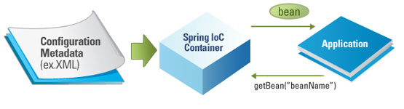
Dependency Injection IoC Container
The Spring container (IoC Container) is at the core of the Spring Framework.
The container will create the objects, wire them together, configure them, and manage their complete lifecycle from creation till destruction.

Slide 6
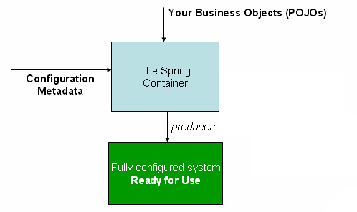
Dependency Injection IoC Container
The container gets its instructions on what objects to instantiate, configure, and assemble by reading configuration metadata provided.
The configuration metadata can be represented either by;
XML,
Java annotations,
Java code.

Slide 7
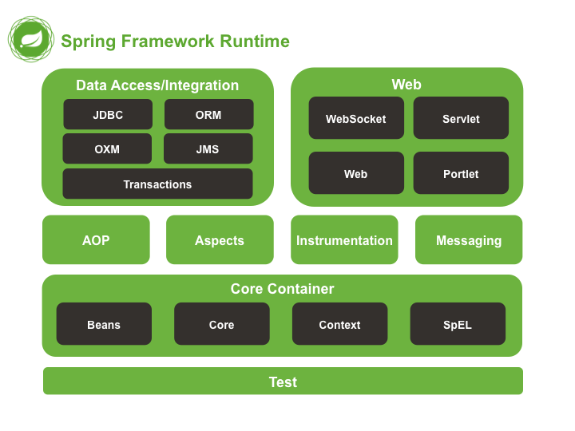
Modules

Slide 8
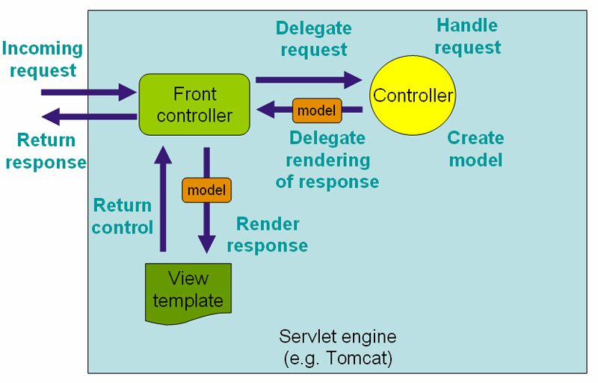
Spring MVC
The Spring web MVC framework provides model-view-controller architecture and ready components that can be used to develop flexible and loosely coupled web applications.
The MVC pattern results in separating the different aspects of the application (input logic, business logic, and UI logic), while providing a loose coupling between these elements.

Slide 9
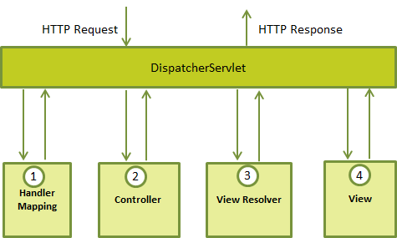
Spring MVC The DispatcherServlet
The Spring Web model-view-controller (MVC) framework is designed around a DispatcherServlet that handles all the HTTP requests and responses.

Slide 10
Important Components
DispatcherServlet
Controller
HandlerMapping/@RequestMapping
ModelAndView
Model & @ModelAttribute
ViewResolver

Slide 11
Advantages
Spring application can be used for the development of different kind of applications, like standalone applications, standalone GUI applications, Web applications and applets as well.
Spring comes with some of the existing technologies like ORM framework, logging framework, J2EE and JDK Timers etc, Hence we don’t need to integrate explicitly those technologies.
Spring achieves the loose coupling through dependency injection.
Modularity: Due to modularly organized nature, Spring makes it easy for the developers to know which packages or classes are to be used and which one should be ignored. No matter how many number of packages and classes are there, it is quite easy for the developers to identify and utilize the usable ones.
Spring is a open source.

Slide 12
Drawbacks
Complex: One of the major problem faced by the Spring framework is that it is complex! No so clear focus, more than 3000 classes, 49 other tools and tons of the other things make it complicated for the developers.
Longer Configuration: If you are a fresher developer, it would be quite difficult for you to learn Spring framework. The main reason behind this is a whole host of new programming methods and detailing require understanding how to set up the Spring XML configuration file.
Require a lot of XML: If you have ever worked with Spring framework, you might be knowing that applications developed using Spring framework often require a huge amount of XML. So, if you are considering Spring for your next development, be prepared to spare a lot of time coding in XML.

